Slide 1
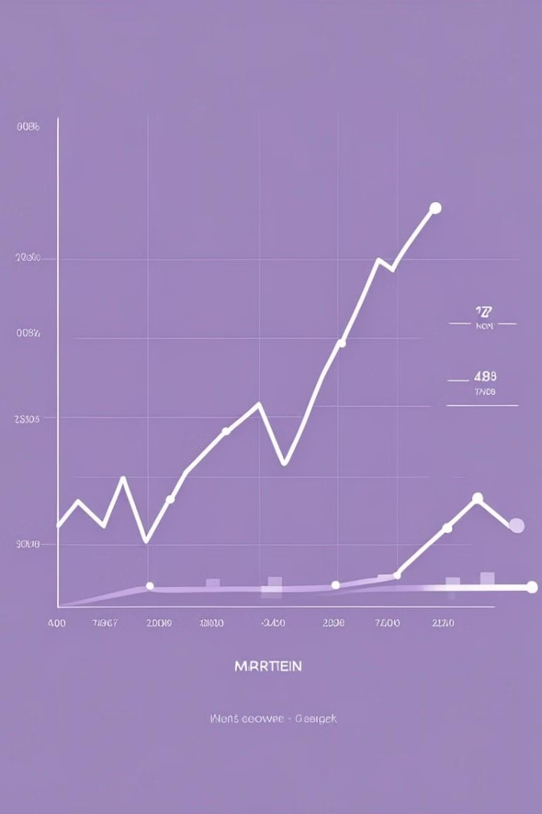
Uncovering Market Trends: A Data-Driven Approach
Dive into the heart of the stock market and uncover the data-driven insights that can guide your investment decisions.
PRESENTED BY
VASANTH V
III YEAR KVCET,CSE
NM ID autlecse202105
GMAIL ID vasanthvalli112@gmail.com

Slide 2
Identifying Patterns
Price Movements
1
Analyze historical stock prices to spot recurring patterns and trends.
2
Trading Volumes
Monitor trading volume fluctuations to understand market sentiment and momentum.
Macroeconomic Indicators
3
Correlate stock performance with broader economic factors like GDP, inflation, and unemployment.

Slide 3
Sector Analysis
Industry Trends
Competitive Landscape
Emerging Opportunities
Identify the sectors and industries that are outperforming or underperforming the overall market.
Understand how companies within a sector are positioned relative to their peers.
Spot new growth areas and innovative industries that could be ripe for investment.

Slide 4
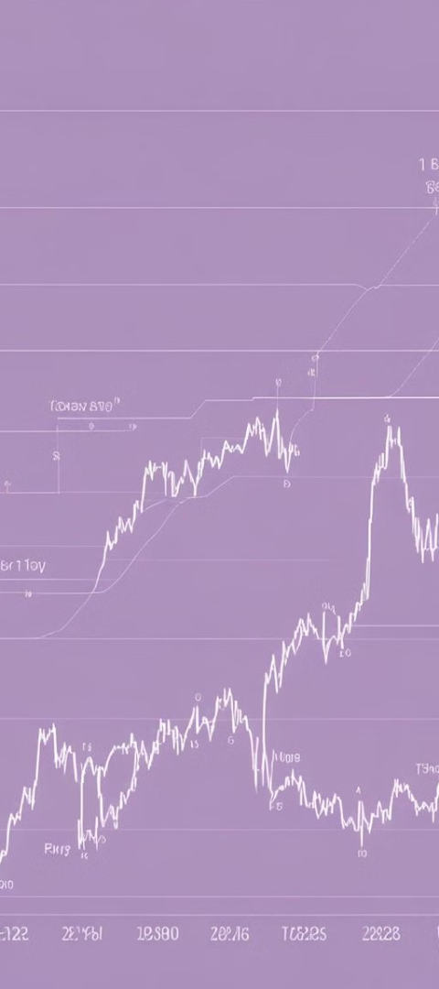
Volatility Dynamics
1
Risk Management
2
Opportunity Identification
Analyze market volatility to develop strategies for mitigating risk and protecting your portfolio.
Recognize periods of high volatility as potential windows for profitable trading opportunities.
3
Investor Sentiment
Monitor market sentiment indicators to gauge the mood and expectations of investors.

Slide 5
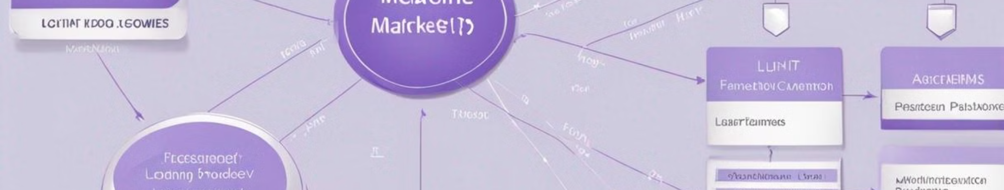
Predictive Analytics
Statistical Modeling
Machine Learning
Scenario Planning
Develop multiple scenarios and simulations to explore potential market outcomes and prepare for various contingencies.
Apply advanced statistical techniques to forecast future market trends and stock price movements.
Leverage AI-powered algorithms to identify complex patterns and make data-driven predictions.

Slide 6




Navigating Market Cycles
Expansion
Contraction
Recovery
Identify periods of economic growth and capitalize on the rising market.
Adapt your investment strategies to weather market downturns and economic recessions.
Recognize the early signs of market recovery and position your portfolio for the next upswing.

Slide 7



Informed Decision-Making
Due Diligence
Data Visualization
Risk Assessment
Conduct thorough research and analysis to make well-informed investment decisions.
Leverage interactive charts and graphs to gain deeper insights and identify trends.
Carefully evaluate the potential risks and rewards associated with each investment opportunity.

Slide 8
Staying Ahead of the Curve
Continuous Learning
Stay up-to-date with the latest industry trends, regulations, and technological advancements.
Adaptability
Develop the flexibility to adjust your investment strategies as the market conditions change.
Diversification
Spread your investments across different asset classes to mitigate risk and capture diverse growth opportunities.

Slide 9
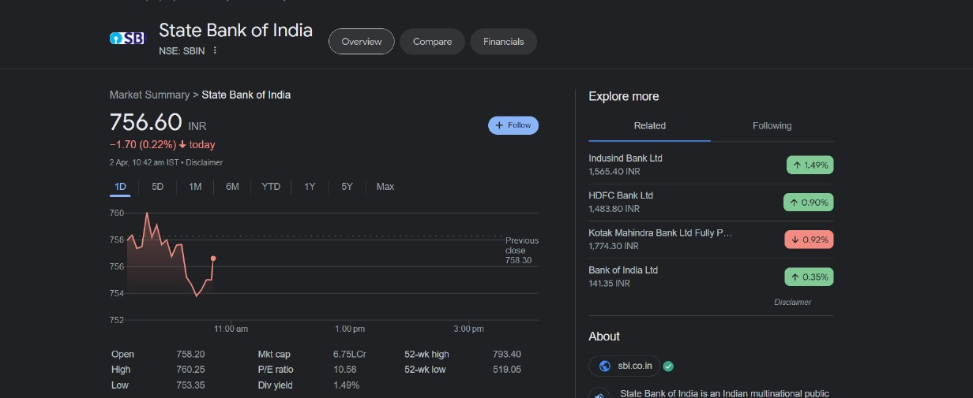
In recent trends, SBI (State Bank of India) stock has displayed a mixed performance, reflecting broader market fluctuations and specific industry dynamics. Over the past few weeks, SBI shares experienced a slight uptrend, driven by positive sentiment surrounding the banking sector and improving economic indicators. Despite these fluctuations, SBI's strong fundamentals and market position have provided support, with investors closely monitoring developments in the banking sector and macroeconomic trends for further cues. Overall, while recent trends have shown some resilience in SBI's stock performance, ongoing market dynamics continue to influence its trajectory, prompting investors to remain vigilant and adapt their strategies accordingly.

